Slide 1
Magenic Masters React Components
Jan 24, 2017
Tim Chan

Slide 2
Agenda
Review
Components
JSX
Rendering in DOM
Type of Components
Lifecycle
Hierarchy

Slide 3
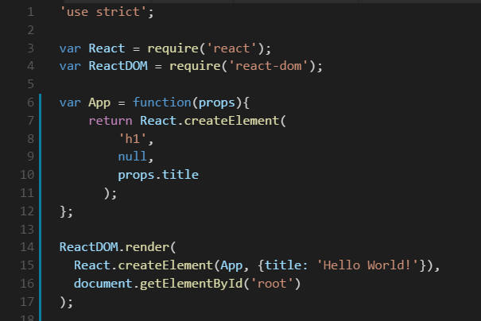
Components
Split the UI into independent, reusable pieces

Slide 4
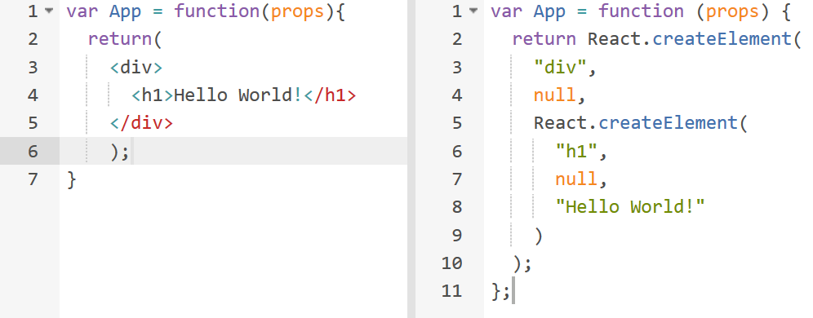
JSX
Provides syntactic sugar for the React.createElement(component, props, ...children) function
Specification - https://github.com/facebook/jsx

Slide 5
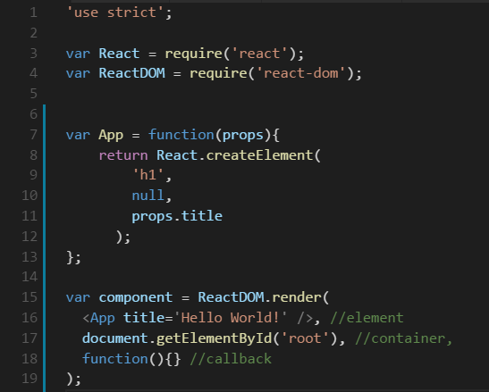
Rendering in DOM
ReactDOM.render(element, container, [callback])
Renders a React element into the DOM container
Uses React’s DOM diffing algorithm for efficient updates
Optional callback function is executed when the component is rendered or updated

Slide 6
Types of Components

Slide 7
Functional Components
Accepts a single "props" object argument with data and returns a React element
Must act as pure function
Stateless and no lifecycle methods
Easier to test
Future optimization
Notes:
They don’t have a persistent this property to attach a ReactComponent instance to. But while a this object expands a component’s possibilities, it also has a cost: keeping a ReactComponent linked up with its ReactElement objects takes work.
By using stateless functional components, you’re signalling to React that you don’t need that ReactComponent. From this, it is able to make a bunch of optimisations — which while currently modest, are set to grow. But even before these performance improvements materialise, there are a number of things your components won’t have to do if they’re classless. Which brings us to the second rule.

Slide 8
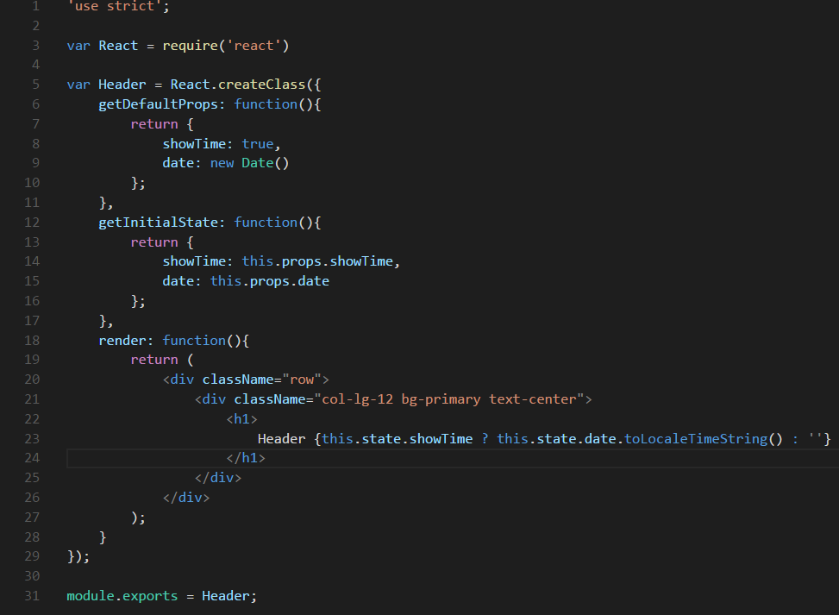
Class Components
Has “this”, the react component instance
Stateful – this.state (internal data)
Lifecycle methods – Mounting, Updating, Unmounting
Additional APIs – this.setState(), this.forceUpdate()

Slide 9
Component Lifecycle

Slide 10
Mounting Methods
Called when an instance of a component is being created and inserted into the DOM
getDefaultProps()
getInitialState()
componentWillMount()
render()
componentDidMount()

Slide 11
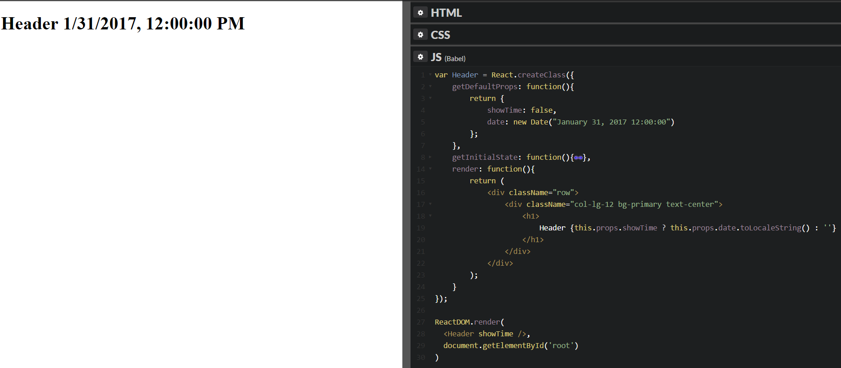
Mounting Methods – getDefaultProps()
Set default props
Any undefined props uses default props

Slide 12
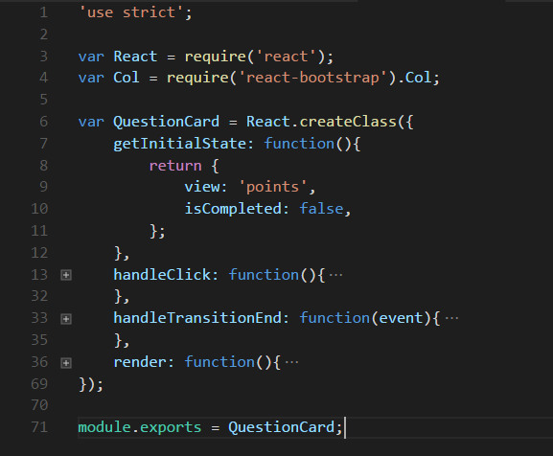
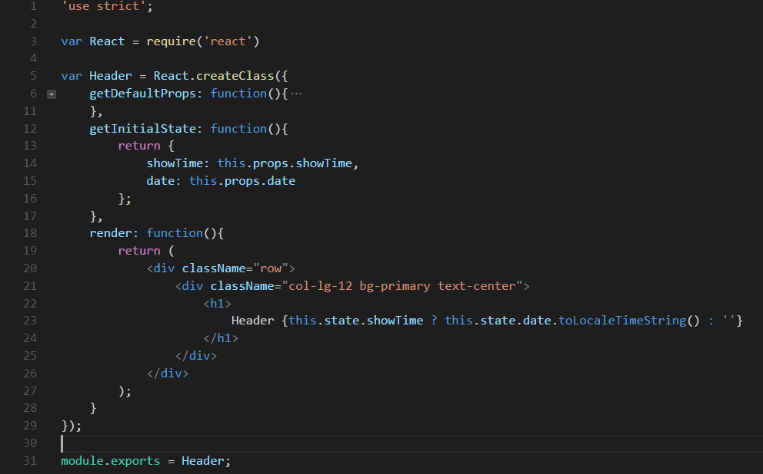
Mounting Methods – getInitialState()
Provide initial state

Slide 13
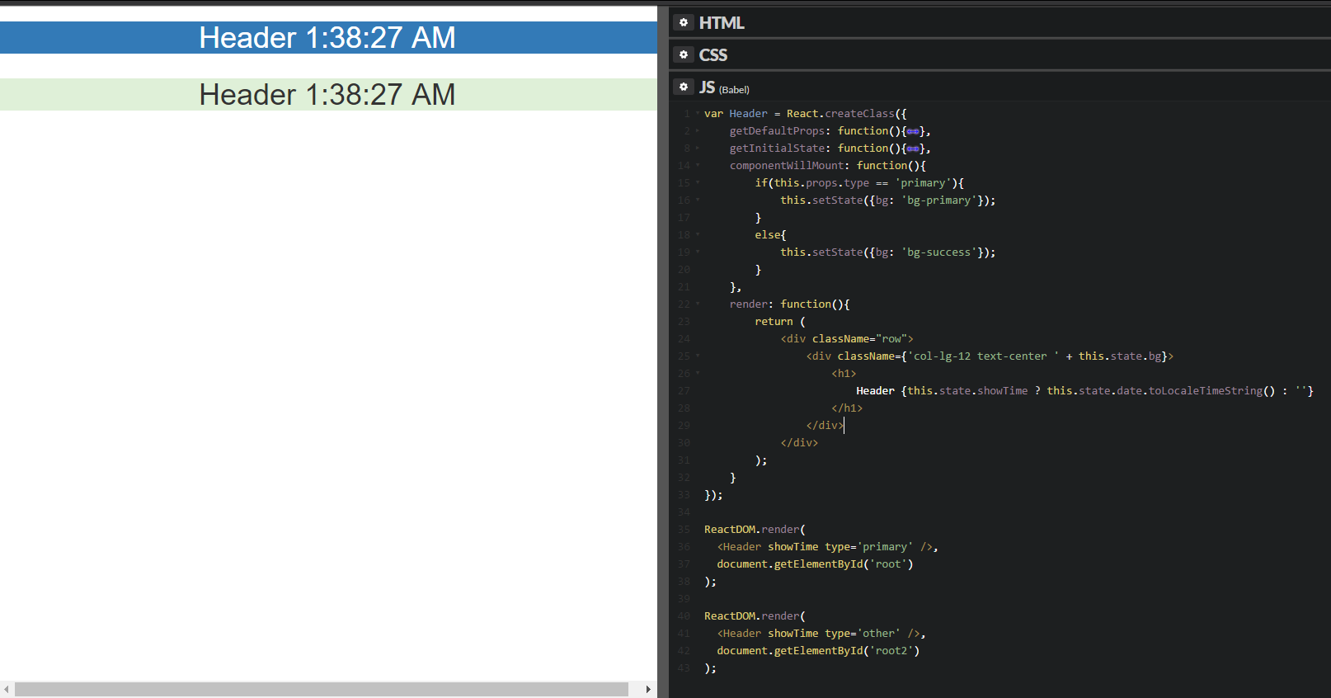
Mounting Methods – componentWillMount()
Handle configuration, update our state, prepare for render

Slide 14
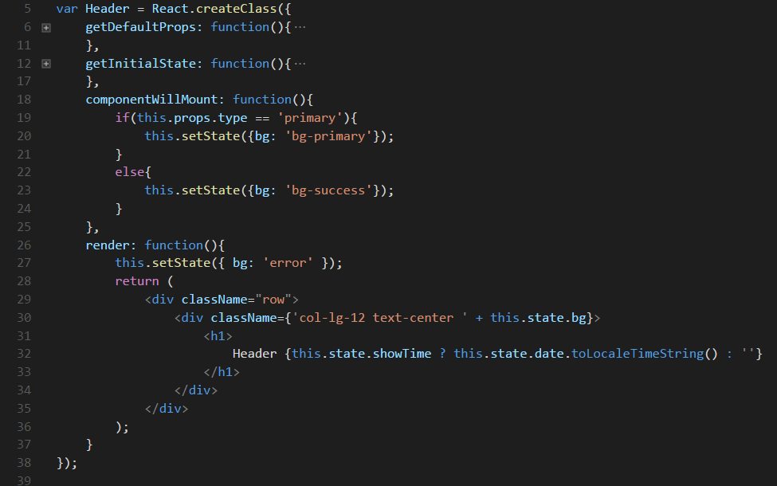
Mounting Methods – render()
Returns a single element to be display or null
One method that lives in multiple life cycle
Must be a pure function (no mutating of state)
Notes:
In the example above we call this.setState() and update our current state before render. If we need state values on calculations passed in props, this is where we should do the logic.
Other uses for componentWillMount() includes registering to global events, such as a Flux store. If your Component needs to respond to global Native UI events, such as window resizing or focus changes, this is a good place to do it

Slide 15
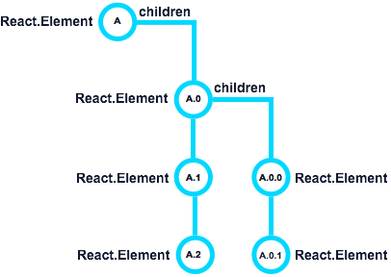
Mounting Methods – componentDidMount()
Called once all our children Elements and our Component instances are mounted
Has access to Native UI/DOM
Interact with DOM, setup 3rd party UIs
render() order
A -> A.0 -> A.0.0 -> A.0.1 -> A.1 -> A.2.
componentDidMount() order
A.2 -> A.1 -> A.0.1 -> A.0.0 -> A.0 -> A

Slide 16
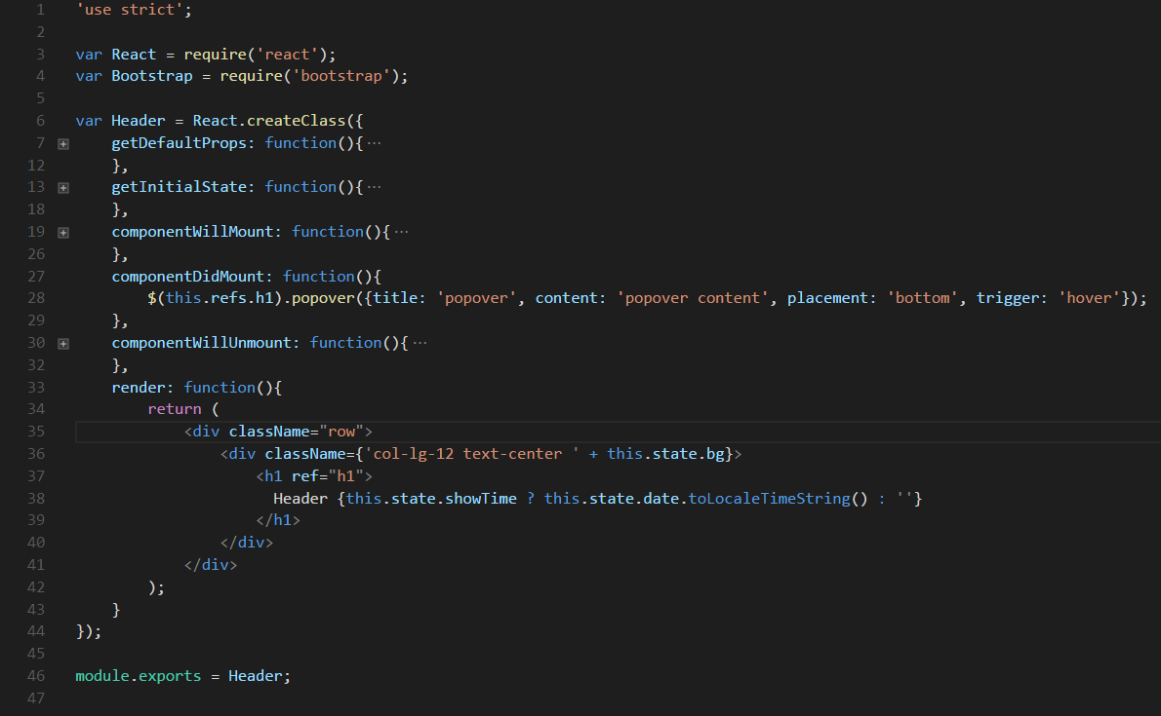
Mounting Methods – componentDidMount()
Example

Slide 17
Updating Methods
Updates are cause by changes in props or state.
Called when a component is being re-rendered
componentWillReceiveProps()
shouldComponentUpdate()
componentWillUpdate()
render()
componentDidUpdate()

Slide 18
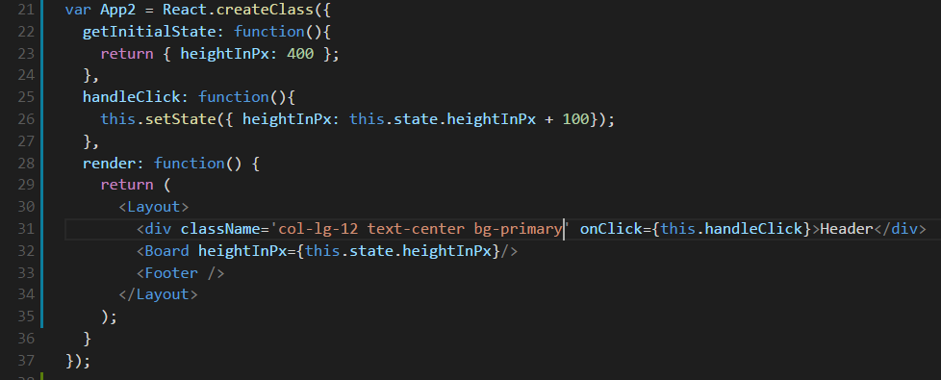
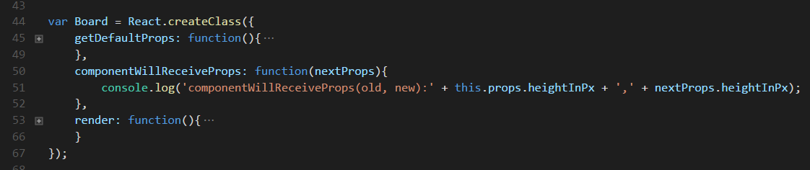
Updating Methods - componentWillReceiveProps()
Access on nextProps
Use for setting state based on new props
Not always trigger in the lifecycle

Slide 19
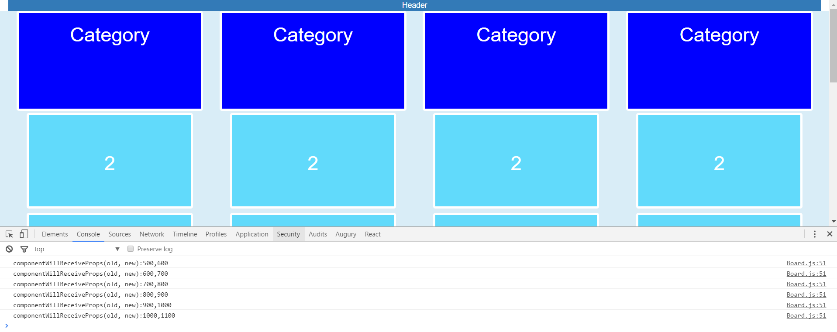
Updating Methods - componentWillReceiveProps()

Slide 20
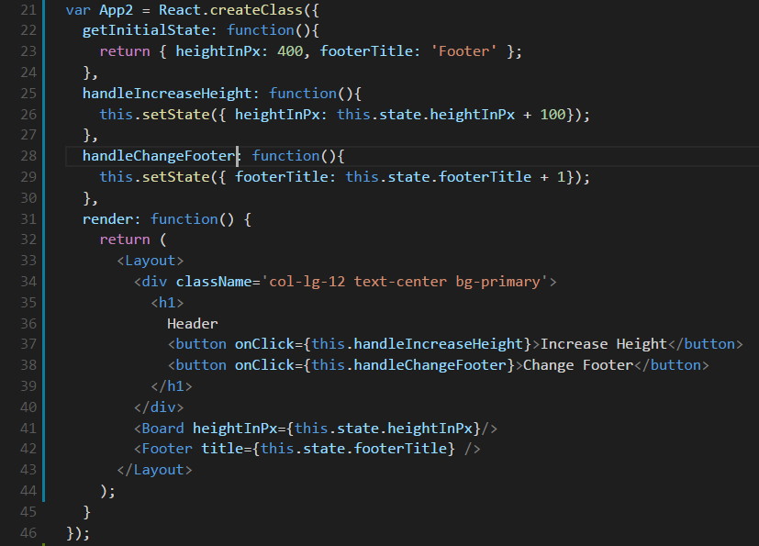
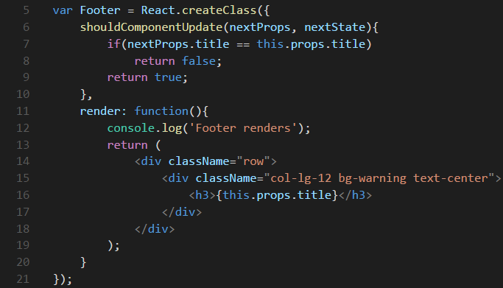
Updating Methods – shouldComponentUpdate()
Access to nextProps and nextState
Allows your Component to exit the Update life cycle if there is no reason to apply a new render
Optimization method to prevent unnecessary re-rendering

Slide 21
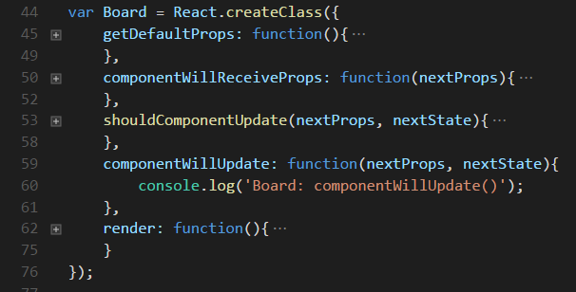
Updating Methods – componentWillUpdate()
Access to nextProps and nextState
Called every time a re-render is required
Do not this.setState() – will result in infinite loop since another componentWillUpdate() will be trigger
Uses: Handle configuration changes, dispatch events, set local variables

Slide 22
Updating Methods – render()
Same render method in the mounting phase.
Notes:
In the example above we call this.setState() and update our current state before render. If we need state values on calculations passed in props, this is where we should do the logic.
Other uses for componentWillMount() includes registering to global events, such as a Flux store. If your Component needs to respond to global Native UI events, such as window resizing or focus changes, this is a good place to do it

Slide 23
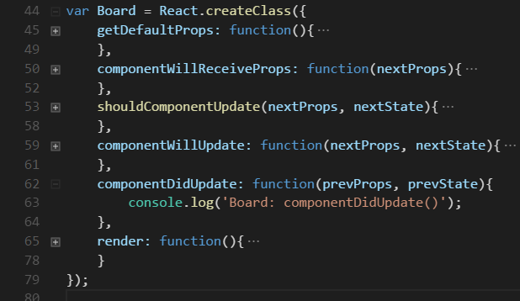
Updating Methods – componentDidUpdate()
Similar to componentDidMount
Access to prevProps and prevState (inverse of componentWillMount())
Has access to Native UI/DOM
Uses: Interact with DOM, setup 3rd party UIs

Slide 24
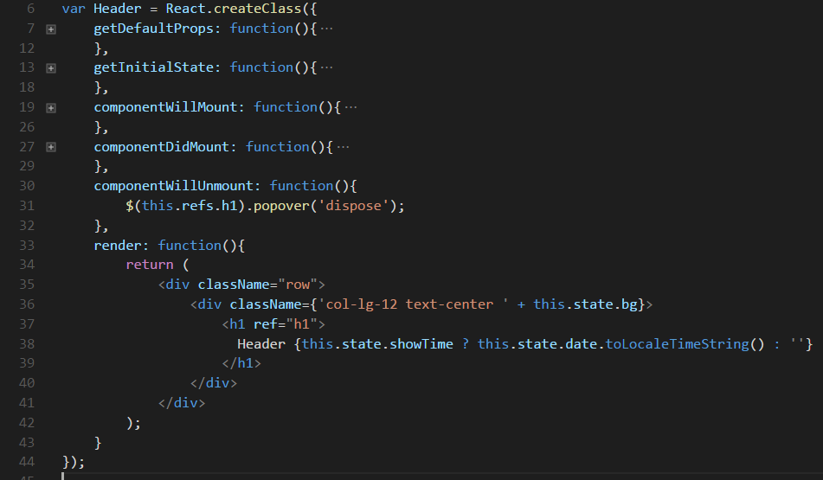
Unmounting Method – componentWillUnmount()
Called once when component is being unmounted in the Native UI/DOM and marked for garbage collection
Prevents memory leaks
Uses: unregister any global/system/library events, destroy 3rd party UI library elements

Slide 25
Lifecycle review
Mounting
Initialize / Construction
getDefaultProps()
getInitialState()
componentWillMount()
render()
Children initialization & life cycle kickoff
componentDidMount()
Updating
componentWillReceiveProps()
shouldComponentUpdate()
componentWillUpdate()
render()
Children Life cycle methods
componentDidUpdate()
Unmounting
componentWillUnmount()
Children Life cycle methods
Instance destroyed for Garbage Collection

Slide 26
Component Hierarchy

Slide 27
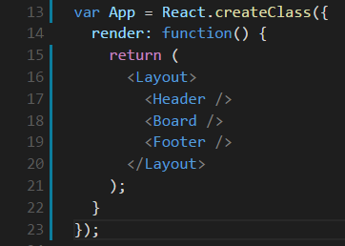
Composition
Allows components to refer other components in their output
Build bigger components using smaller building blocks

Slide 28
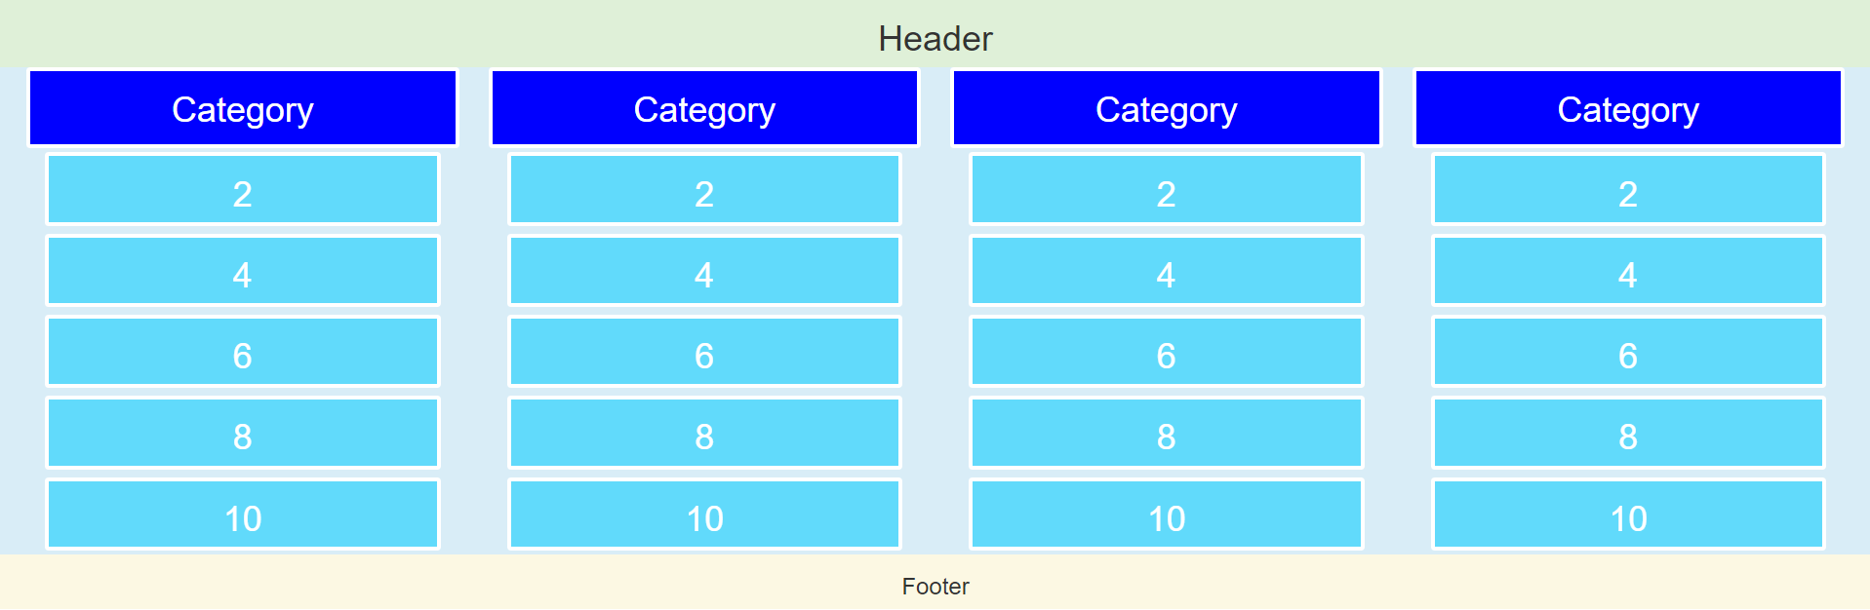
Thinking in components

Slide 29
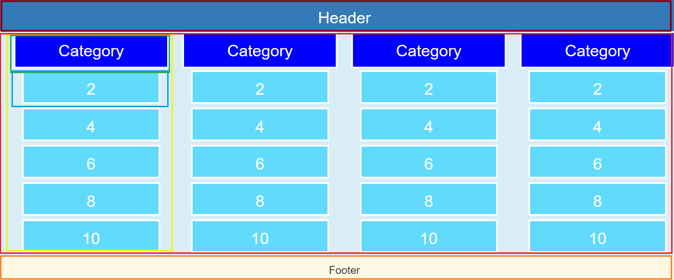
Thinking in components
App
Layout
Header
Section
Board
Question Category
Category
Card
Footer

Slide 30
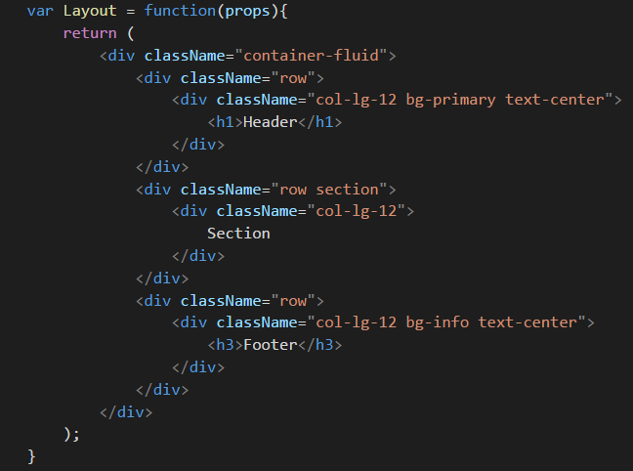
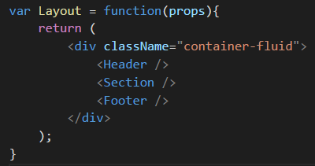
Splitting UI into components

Slide 31
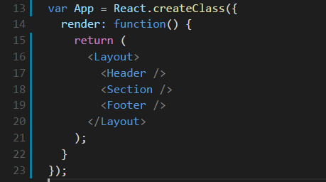
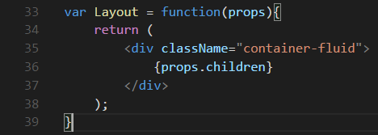
Props.children
Special prop that is defined by the child tags in the JSX expression.

Slide 32
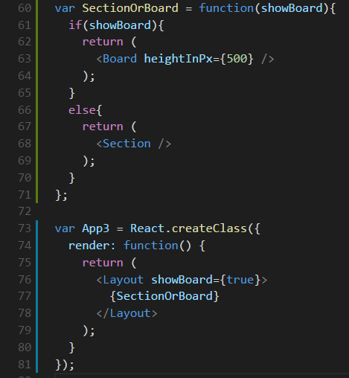
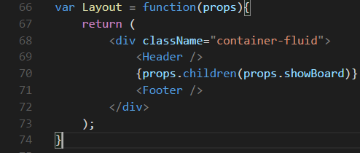
Props.children
It can also be a function

Slide 33

Questions?

Slide 34
Next session…
Quiz
Assignment

